Slide 1
Internet of Things VII Sem Dept of CSE, NIT Raipur Unit II IoT Protocols IoT Access Technologies Topic The Network Layer, IP Versions
Dr. Veena Anand

Slide 2
The network layer: Constrained Nodes
In IoT solutions, different classes of devices coexist. Depending on its functions in a network, “thing” architecture may or may not offer similar characteristics compared to a generic PC or server in an IT environment.
Another limit is that this network protocol stack on an IoT node may be required to communicate through an unreliable path.
Even if a full IP stack is available on the node, this causes problems such as limited or unpredictable throughput and low convergence when a topology change occurs.
Finally, power consumption is a key characteristic of constrained nodes.

Slide 3
The network layer: Constrained Nodes
Many IoT devices are battery powered, with lifetime battery requirements varying from a few months to 10+ years.
This drives the selection of networking technologies since high-speed ones, such as Ethernet, Wi-Fi, and cellular, are not (yet) capable of multi-year battery life.
Current capabilities practically allow less than a year for these technologies on battery-powered nodes.
Of course, power consumption is much less of a concern on nodes that do not require batteries as an energy source.

Slide 4
The network layer: Constrained Nodes
The power consumption requirements on battery-powered nodes impact communication intervals.
To help extend battery life, one could enable a “low-power” mode instead of one that is “always on.”
Another option is “always off,” which means communications are enabled only when needed to send data.
While it has been largely demonstrated that production IP stacks perform well in constrained nodes. IoT constrained nodes can be classified as follows:

Slide 5
The network layer: Constrained Nodes
Devices that are very constrained in resources, may communicate infrequently to transmit a few bytes, and may have limited security and management capabilities:
This drives the need for the IP adaptation model, where nodes communicate through gateways and proxies.
Devices with enough power and capacities to implement a stripped-down IP stack or non- IP stack:
In this case, you may implement either an optimized IP stack and directly communicate with application servers (adoption model) or go for an IP or non-IP stack and communicate through gateways and proxies (adaptation model).

Slide 6
The network layer: Constrained Nodes
Devices that are similar to generic PCs in terms of computing and power resources but have constrained networking capacities, such as bandwidth:
These nodes usually implement a full IP stack (adoption model), but network design and application behaviors must cope with the bandwidth constraints.

Slide 7
The network layer: Constrained Nodes
The definition of constrained nodes is evolving. The costs of computing power, memory, storage resources, and power consumption are generally decreasing.
At the same time, networking technologies continue to improve and offer more bandwidth and reliability.
In the future, the push to optimize IP for constrained nodes will lessen as technology improvements and cost decreases address many of these challenges.

Slide 8
The network layer: Constrained Networks
In the early years of the Internet, network bandwidth capacity was restrained due to technical limitations.
Connections often depended on low-speed modems for transferring data.
However, these low-speed connections demonstrated that IP could run over low-bandwidth networks.
But today, the evolution of networking has seen the emergence of high-speed infrastructures.

Slide 9
The network layer: Constrained Networks
However, high-speed connections are not usable by some IoT devices in the last mile.
The reasons include the implementation of technologies with low bandwidth, limited distance and bandwidth due to regulated transmit power, and lack of or limited network services.
When link layer characteristics that we take for granted are not present, the network is constrained.
A constrained network can have high latency and a high potential for packet loss.

Slide 10
The network layer: Constrained Networks
Constrained networks have unique characteristics and requirements.
In contrast with typical IP networks, where highly stable and fast links are available, constrained networks are limited by low-power, low bandwidth links (wireless and wired).
They operate between a few kbps and a few hundred kbps and may utilize a star, mesh, or combined network topologies, ensuring proper operations.
With a constrained network, in addition to limited bandwidth, it is not unusual for the packet delivery rate (PDR) to oscillate between low and high percentages.

Slide 11
The network layer: Constrained Networks
Large bursts of unpredictable errors and even loss of connectivity at times may occur.
These behaviours can be observed on both wireless and narrowband power-line communication links, where packet delivery variation may fluctuate greatly during the course of a day.
Unstable link layer environments create other challenges in terms of latency and control plane reactivity.
One of the golden rules in a constrained network is to “underreact to failure.”

Slide 12
The network layer: Constrained Networks
Due to the low bandwidth, a constrained network that overreacts can lead to a network collapse—which makes the existing problem worse.
Control plane traffic must also be kept at a minimum; otherwise, it consumes the bandwidth that is needed by the data traffic.
Finally, one has to consider the power consumption in battery-powered nodes.
Any failure or verbose control plane protocol may reduce the lifetime of the batteries.

Slide 13
The network layer: Constrained Networks
To summarize, constrained nodes and networks pose major challenges for IoT connectivity in the last mile.
This in turn has led various standards organizations to work on optimizing protocols for IoT.

Slide 14
IP Versions
For 20+ years, the IETF has been working on transitioning the Internet from IP version 4 to IP version 6.
The main driving force has been the lack of address space in IPv4 as the Internet has grown.
IPv6 has a much larger range of addresses that should not be exhausted for the foreseeable future.
Today, both versions of IP run over the Internet, but most traffic is still IPv4 based.

Slide 15
IP Versions
While it may seem natural to base all IoT deployments on IPv6, you must take into account current infrastructures and their associated lifecycle of solutions, protocols, and products.
IPv4 is entrenched in these current infrastructures, and so support for it is required in most cases.
Therefore, the Internet of Things has to follow a similar path as the Internet itself and support both IPv4 and IPv6 versions concurrently.

Slide 16
IP Versions
Techniques such as tunnelling and translation need to be employed in IoT solutions to ensure interoperability between IPv4 and IPv6.
A variety of factors dictate whether IPv4, IPv6, or both can be used in an IoT solution.
Most often these factors include a legacy protocol or technology that supports only IPv4.
Newer technologies and protocols almost always support both IP versions.
The following are some of the main factors applicable to IPv4 and IPv6 support in an IoT solution:

Slide 17
IP Versions
Application Protocol:
IoT devices implementing Ethernet or Wi-Fi interfaces can communicate over both IPv4 and IPv6.
But the application protocol may dictate the choice of the IP version.
For example, SCADA protocols such as DNP3/IP (IEEE 1815),Modbus TCP, or the IEC 60870-5-104 standards are specified only for IPv4.
So, there are no known production implementations by vendors of these protocols over IPv6 today.

Slide 18
IP Versions
Application Protocol:
For IoT devices with application protocols defined by the IETF, such as HTTP/HTTPS, CoAP, MQTT, and XMPP, both IP versions are supported.
The selection of the IP version is only dependent on the implementation.

Slide 19
IP Versions
Cellular Provider and Technology:
IoT devices with cellular modems are dependent on the generation of the cellular technology as well as the data services offered by the provider.
For the first three generations of data services—GPRS, Edge, and 3G— IPv4 is the base protocol version.
Consequently, if IPv6 is used with these generations, it must be tunneled over IPv4.
On 4G/LTE networks, data services can use IPv4 or IPv6 as a base protocol, depending on the provider.

Slide 20
IP Versions
Serial Communications:
Many legacy devices in certain industries, such as manufacturing and utilities, communicate through serial lines.
Data is transferred using either proprietary or standards based protocols, such as DNP3, Modbus, or IEC 60870-5-101.
In the past, communicating this serial data over any sort of distance could be handled by an analog modem connection.
However, as service provider support for analog line services has declined, the solution for communicating with these legacy devices has been to use local connections.

Slide 21
IP Versions
Serial Communications:
To make this work, you connect the serial port of the legacy device to a nearby serial port on a piece of communications equipment, typically a router.
This local router then forwards the serial traffic over IP to the central server for processing.
Encapsulation of serial protocols over IP leverages mechanisms such as raw socket TCP or UDP.
While raw socket sessions can run over both IPv4 and IPv6, current implementations are mostly available for IPv4 only.

Slide 22
IP Versions
IPv6 Adaptation Layer:
IPv6-only adaptation layers for some physical and data link layers for recently standardized IoT protocols support only IPv6.
While the most common physical and data link layers (Ethernet, Wi-Fi, and so on) stipulate adaptation layers for both versions, newer technologies, such as IEEE 802.15.4 (Wireless Personal Area Network), IEEE 1901.2, and ITU G.9903 (Narrowband Power Line Communications) only have an IPv6 adaptation layer specified.

Slide 23
IP Versions
IPv6 Adaptation Layer:
This means that any device implementing a technology that requires an IPv6 adaptation layer must communicate over an IPv6-only sub network.
This is reinforced by the IETF routing protocol for LLNs, RPL, which is IPv6 only.

Slide 24
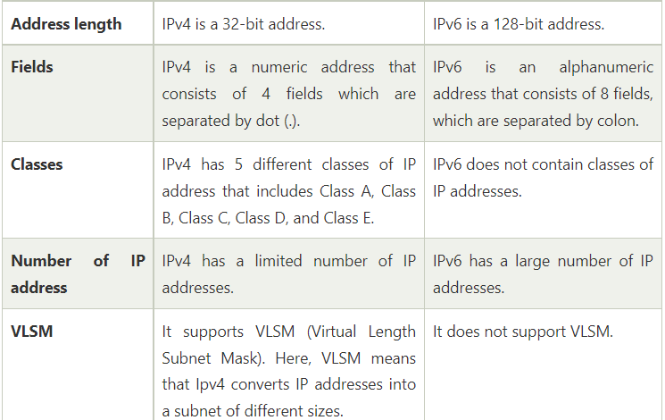
IP Versions
IPV4 IPV6

Slide 25
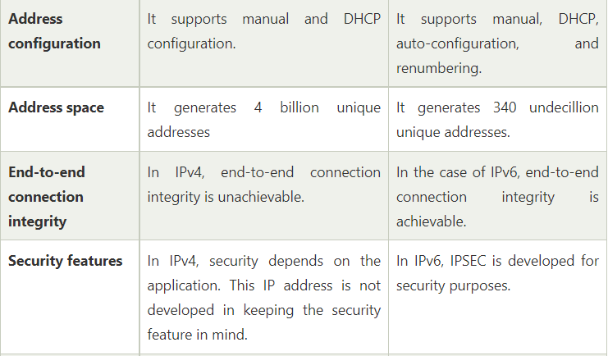
IP Versions
IPV4 IPV6

Slide 26
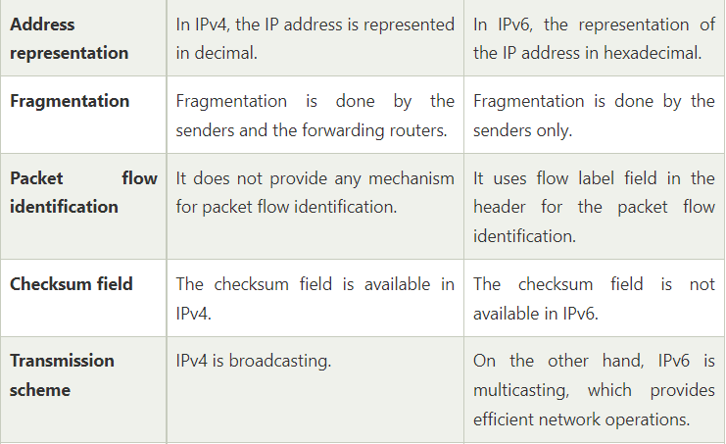
IP Versions
IPV4 IPV6

Slide 27
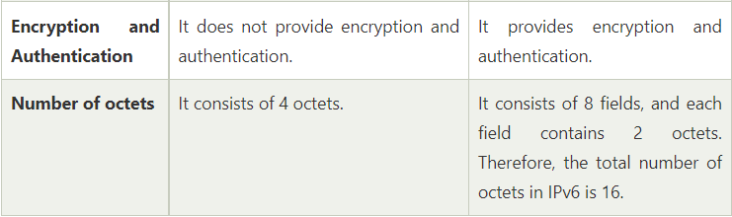
IP Versions
IPV4 IPV6

